Slide 1
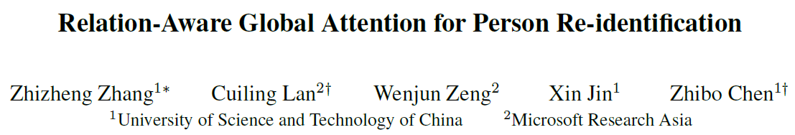
Attention in CNN
孙志新

Slide 2
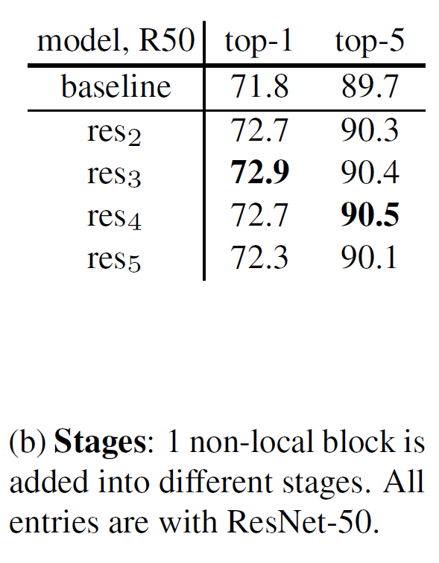
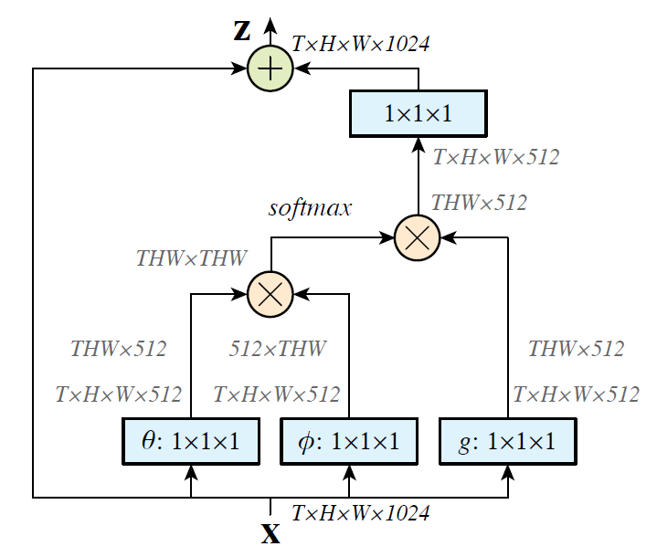
local
VS
global
Non-local Neural Networks <CVPR 2018>

Slide 3
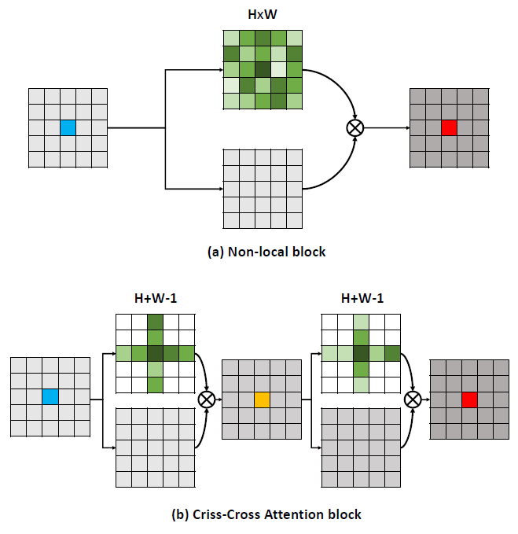
less
vs
more
每个元素都对应一个H*W的矩阵
CCNet: Criss-Cross Attention for Semantic Segmentation <ICCV2019>

Slide 4
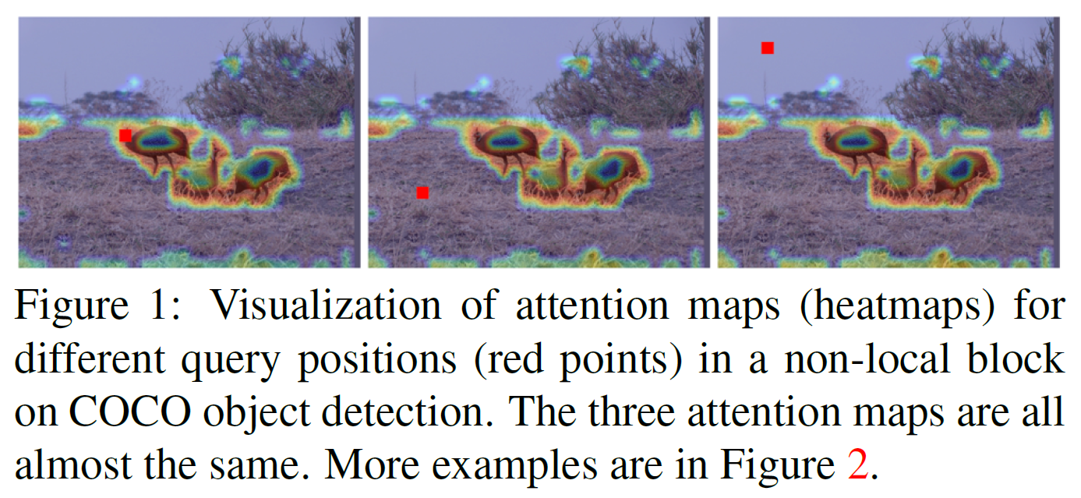
GCNet: Non-local Networks Meet Squeeze-Excitation Networks and Beyond <ICCV2019>

Slide 5
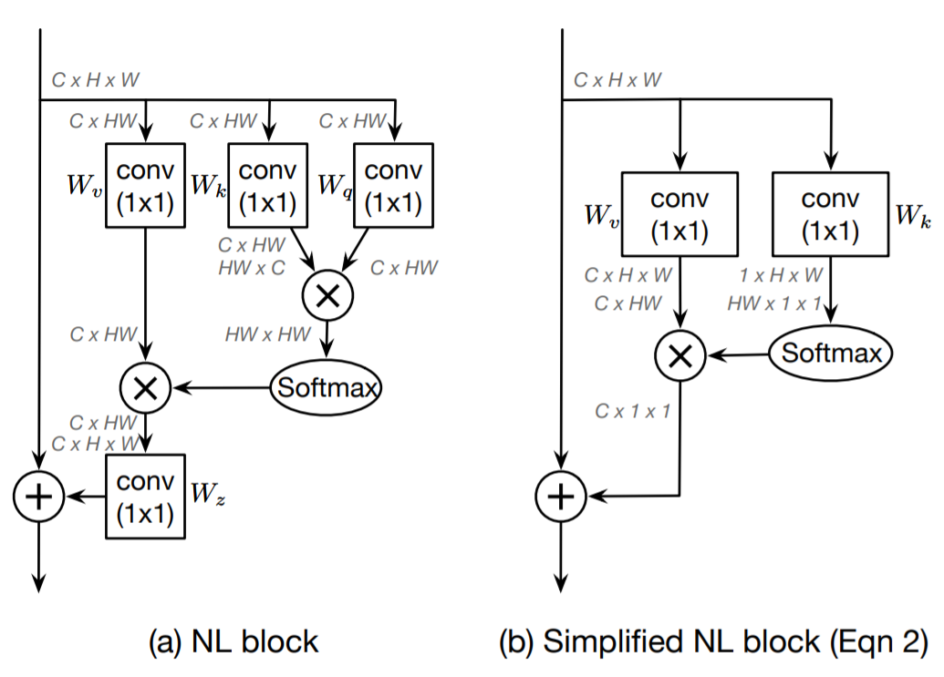
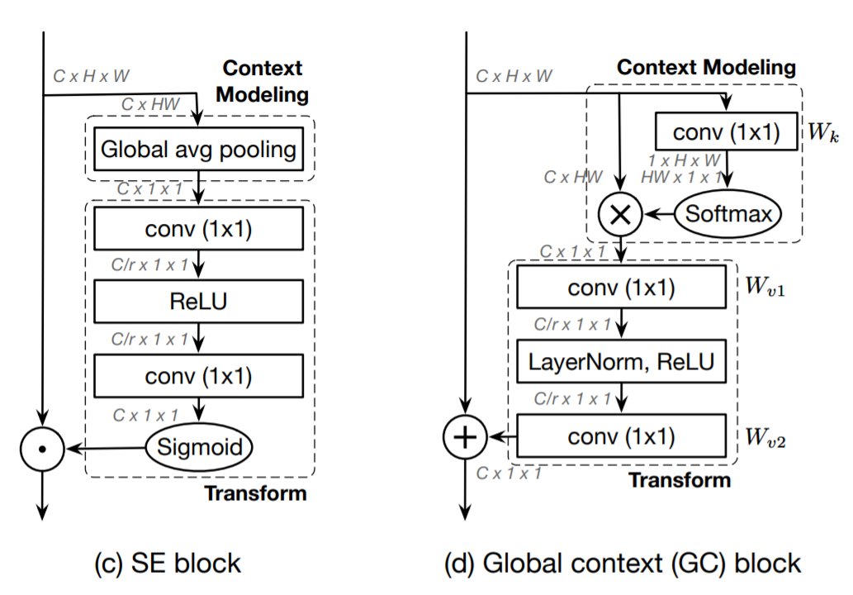
GCNet: Non-local Networks Meet Squeeze-Excitation Networks and Beyond <ICCV2019>

Slide 6


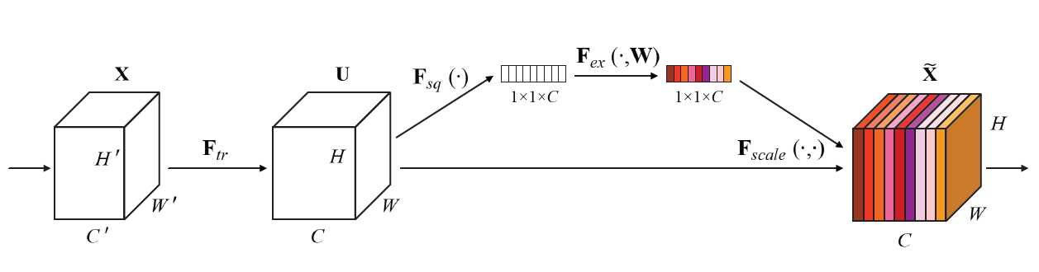
channel attention
每一个H*W共享一个权值
Squeeze-and-Excitation Networks <CVPR 2018>

Slide 7
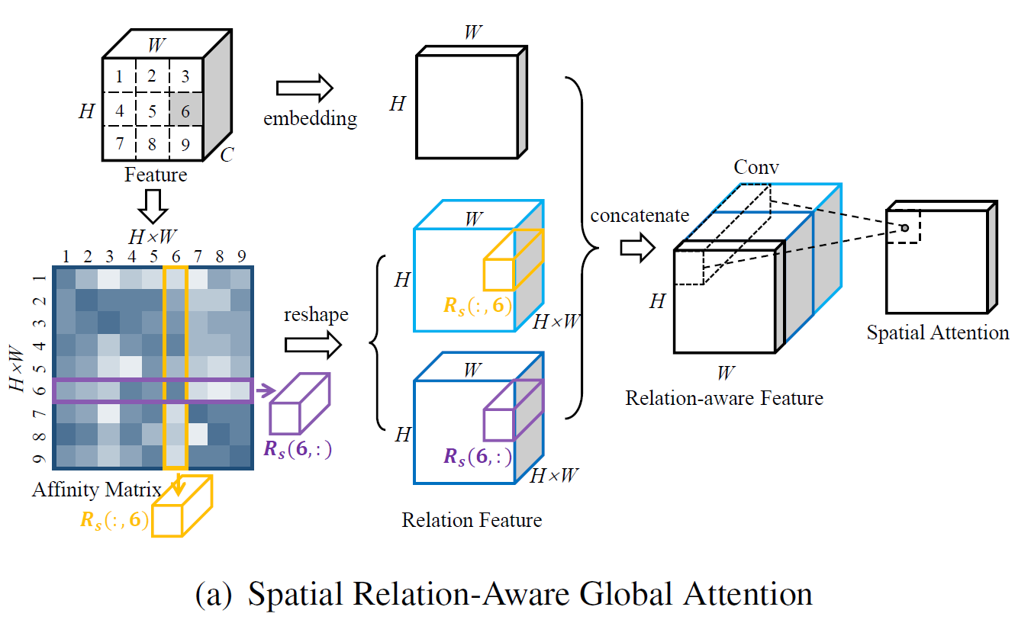


对于每一个注意力权值，不仅仅考虑了自身与周围特征的关系，还考虑了周围特征之间相互之间的关系
$$r_{i,j}=f_{s}\left(x_{i},x_{j}\right)=θ_{s}{\left(x_{i}\right)}^{T}φ_{s}\left(x_{j}\right)$$
$$φ_{s}\left(x_{i}\right)=ReLU\left(W_{φ}x_{i}\right)$$
关系是相互的
Supplementary Material: Relation-Aware Global Attention for Person Re-identification <CVPR 2020>

Slide 8
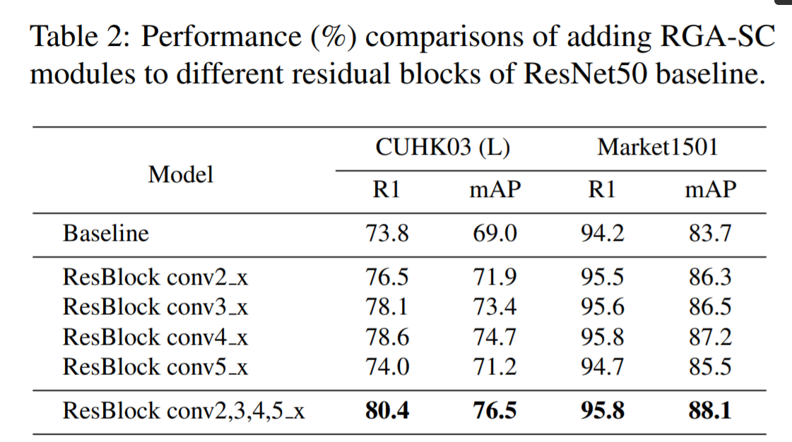
For the lower layers conv2 x, only limited low-level semantics can be captured.
For the higher layers conv5 x, there is less room for feature improvement.
Supplementary Material: Relation-Aware Global Attention for Person Re-identification <CVPR 2020>

Slide 9
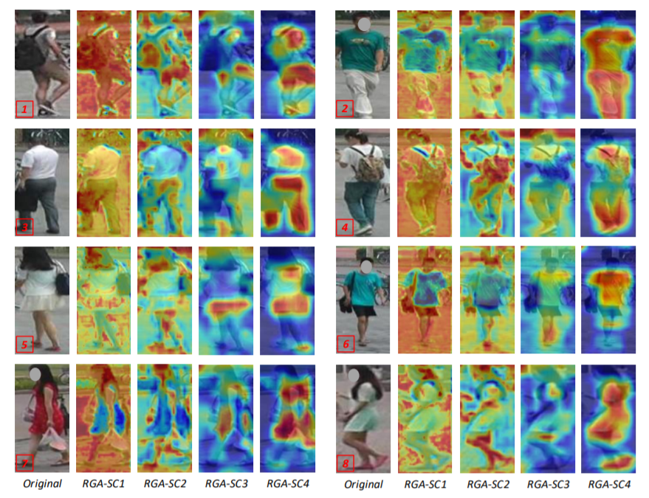
From RGA-SC1 to RGA-SC4, it seems that the semantics are captured progressively as the depth increases
For the lower layer like RGA-SC2, the attention map presents clustering-like patterns at finer granularity levels. The parts/regions with similar semantics are likely to have similar attention responses.
Supplementary Material: Relation-Aware Global Attention for Person Re-identification <CVPR 2020>

Slide 10
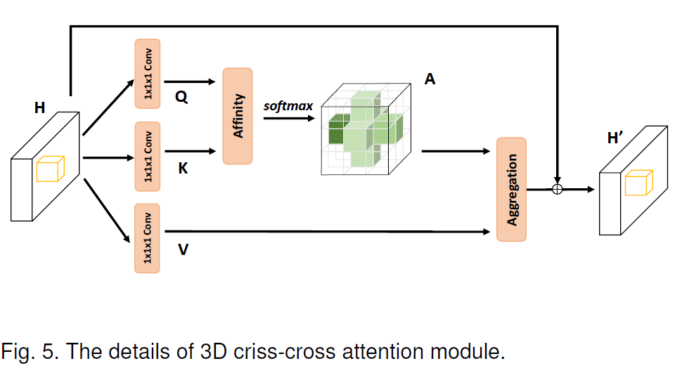
CCNet: Criss-Cross Attention for Semantic Segmentation <ICCV2019>

Slide 11
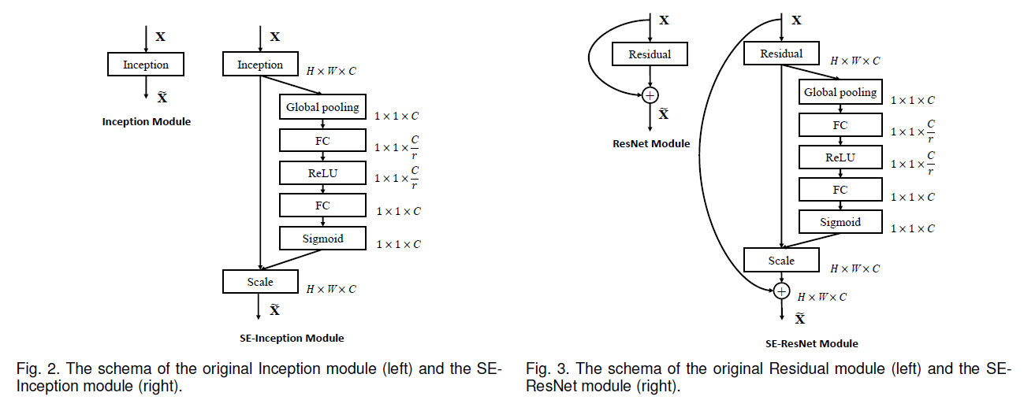
Squeeze-and-Excitation Networks <2018>

Slide 12


Squeeze-and-Excitation Networks <2018>

Slide 13
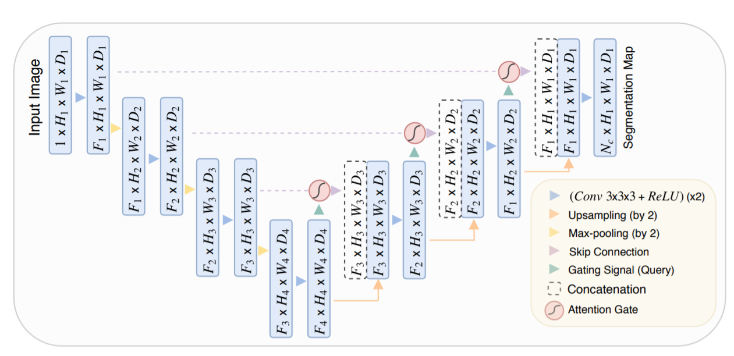
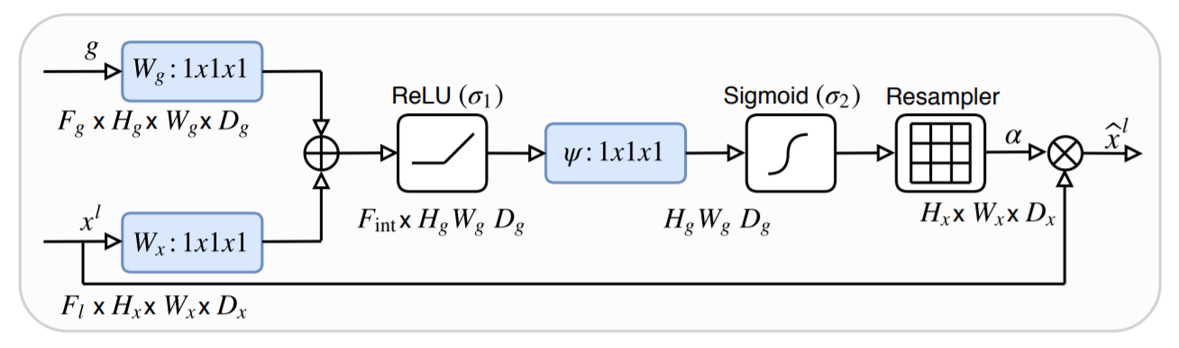
Attention U-Net: Learning Where to Look for the Pancreas <2018>

Slide 14
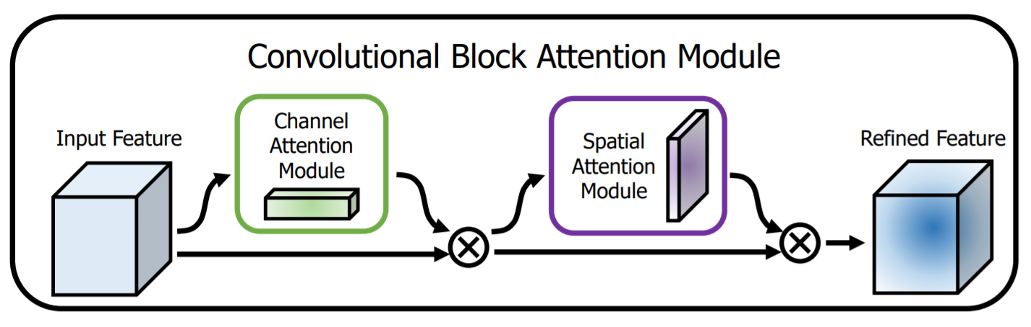
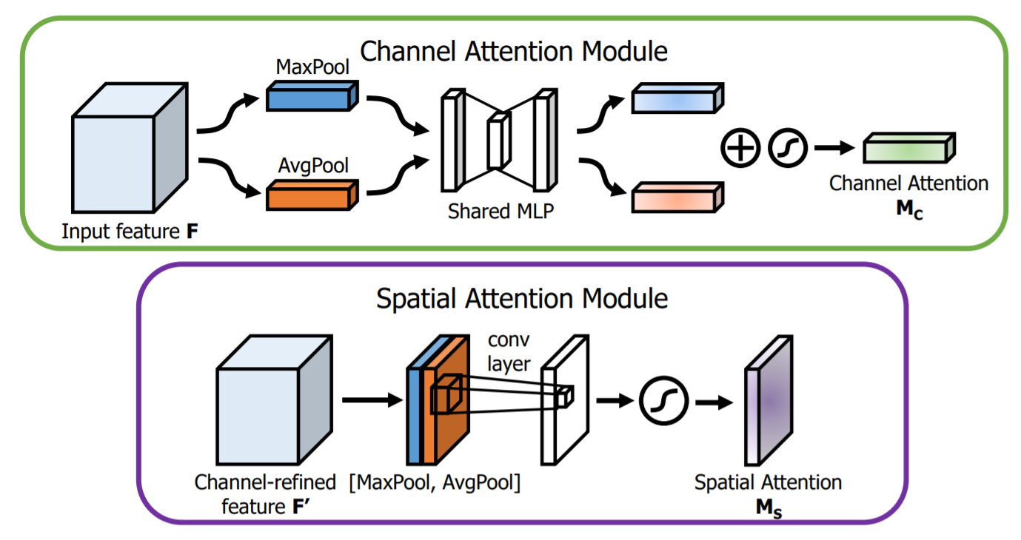
CBAM: Convolutional Block Attention Module

Slide 15
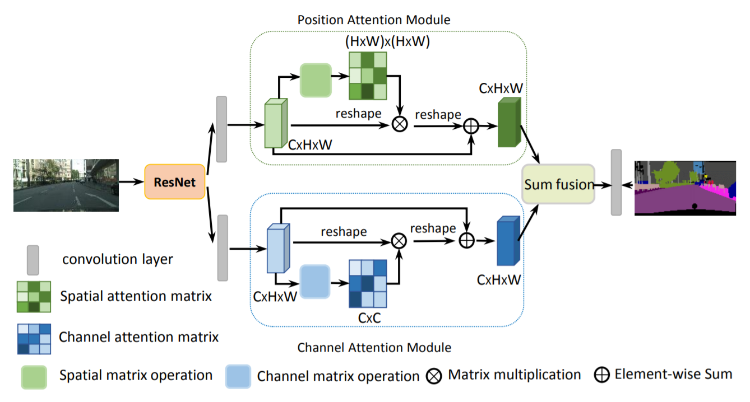
Dual Attention Network for Scene Segmentation

Slide 16
谢谢

